Slide 1
Tutorial-14
1) Design a Synchronous Mod-6 Gray counter using T- Flip Flops.
Soln:- Total no. of flip flops required will be= ?

Slide 2
2) Design a Synchronous BCD counter using J-K Flip Flops.
Soln:- Total no. of flip flops required will be= ?

Slide 3
Binary to Gray conversion Table
Decimal Binary—Gray
(0) 000---000
(1) 001---001
(2) 010---011
(3) 011---010
(4) 100---110
(5) 101---111
Previous state |  |  | Next state |  |  | Required excitations
Q3 | Q2 | Q1 | Q3 | Q2 | Q1 | T3 | T2 | T1
0 | 0 | 0 | 0 | 0 | 1 | 0 | 0 | 1
0 | 0 | 1 | 0 | 1 | 1 | 0 | 1 | 0
0 | 1 | 1 | 0 | 1 | 0 | 0 | 0 | 1
0 | 1 | 0 | 1 | 1 | 0 | 1 | 0 | 0
1 | 1 | 0 | 1 | 1 | 1 | 0 | 0 | 1
1 | 1 | 1 | 0 | 0 | 0 | 1 | 1 | 1
2,7
1,7
0,3,6,7

Slide 4
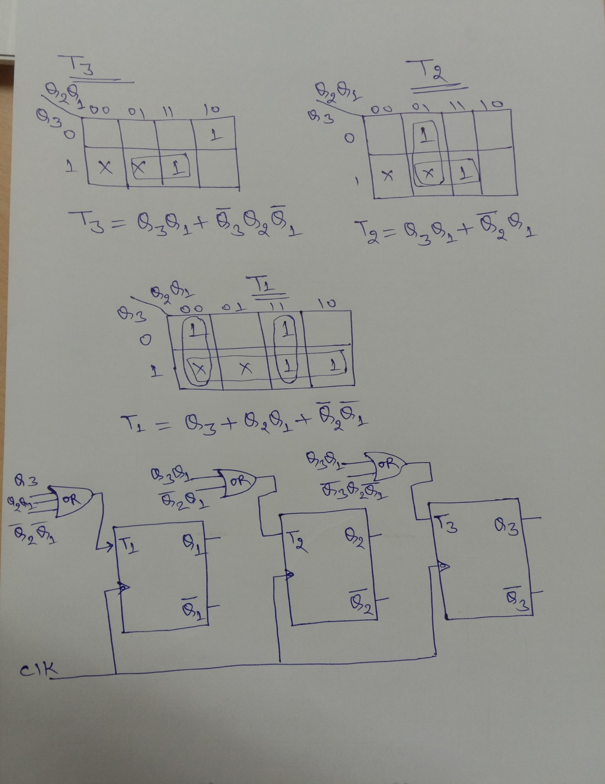

Slide 5
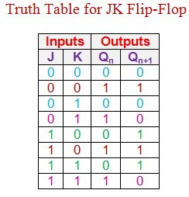
J-K table
Previous state |  |  |  | Next state |  |  |  | Required excitations
Q4 | Q3 | Q2 | Q1 | Q4 | Q3 | Q2 | Q1 | J4 | K4 | J3 | K3 | J2 | K2 | J1 | K1
0 | 0 | 0 | 0 | 0 | 0 | 0 | 1 | 0 | X | 0 | X | 0 | X | 1 | X
0 | 0 | 0 | 1 | 0 | 0 | 1 | 0 | 0 | X | 0 | X | 1 | X | X | 1
0 | 0 | 1 | 0 | 0 | 0 | 1 | 1 | 0 | X | 0 | X | X | 0 | 1 | X
0 | 0 | 1 | 1 | 0 | 1 | 0 | 0 | 0 | X | 1 | X | X | 1 | X | 1
0 | 1 | 0 | 0 | 0 | 1 | 0 | 1 | 0 | X | X | 0 | 0 | X | 1 | X
0 | 1 | 0 | 1 | 0 | 1 | 1 | 0 | 0 | X | X | 0 | 1 | X | X | 1
0 | 1 | 1 | 0 | 0 | 1 | 1 | 1 | 0 | X | X | 0 | X | 0 | 1 | X
0 | 1 | 1 | 1 | 1 | 0 | 0 | 0 | 1 | X | X | 1 | X | 1 | X | 1
1 | 0 | 0 | 0 | 1 | 0 | 0 | 1 | X | 0 | 0 | X | 0 | X | 1 | X
1 | 0 | 0 | 1 | 0 | 0 | 0 | 0 | X | 1 | 0 | X | 0 | X | X | 1
7
9
1,3,5,7,9

Slide 6
